Slide 1
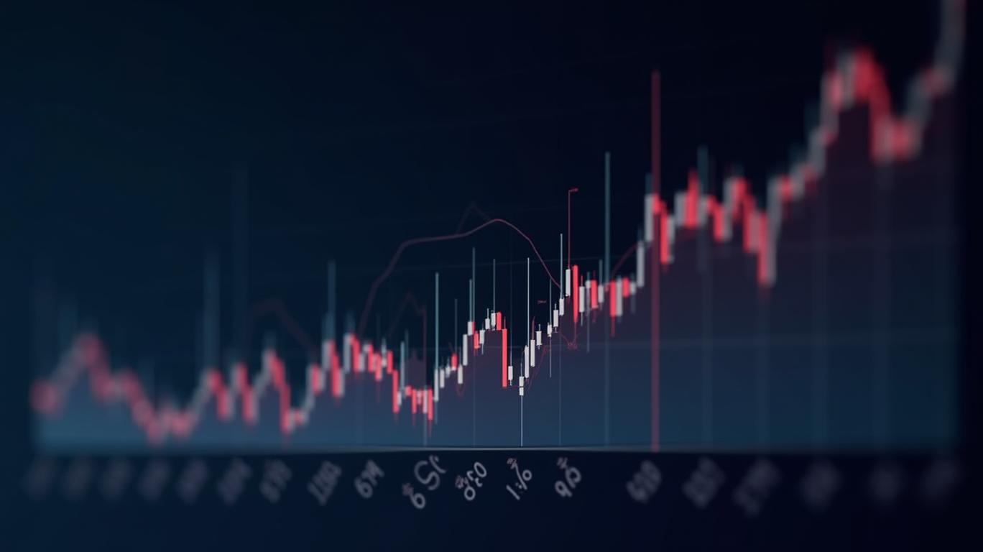
Title: "Apple Stock Analysis: Predicting Price Movements" Subtitle: "Big Data Analytics Capstone Project" Details: Rukundo Espoir, Date (August 3, 2025), Course Name

Slide 2
Project Introduction
Problem: Predict short-term stock price movements for Apple Inc. and identify factors influencing volatility.
Objective: Use Big Data Analytics to analyze historical stock data (1980–2025) and build predictive models.
Importance: Inform investment strategies and understand market trends.

Slide 3
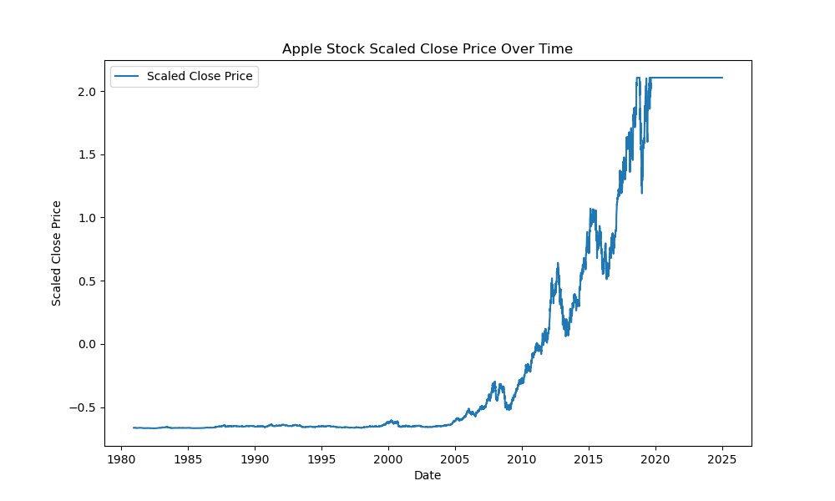
Methodology
Data Cleaning: Renamed columns, handled missing values, capped outliers, scaled numerical columns, added 7-day moving average (MA_7).
EDA: Generated descriptive statistics, visualized trends (time-series), distributions (histogram), correlations (heatmap), and volume-price relationships (scatter).
Modeling: Trained Linear Regression to predict next day’s Close price using features (Adj_Close, High, Low, Open, Volume, MA_7).
Evaluation: Calculated RMSE and MAE, visualized actual vs. predicted prices.
Dashboard: Built Power BI dashboard with interactive slicers and visuals.

Slide 4
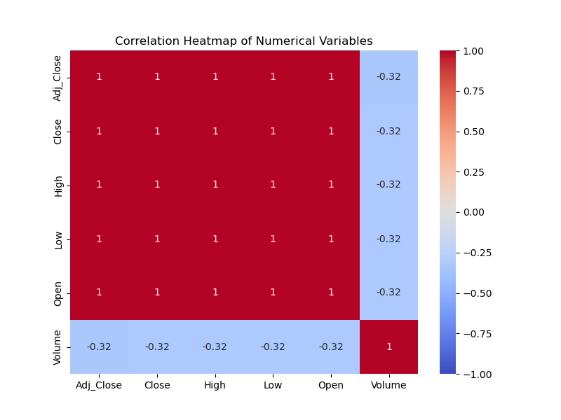
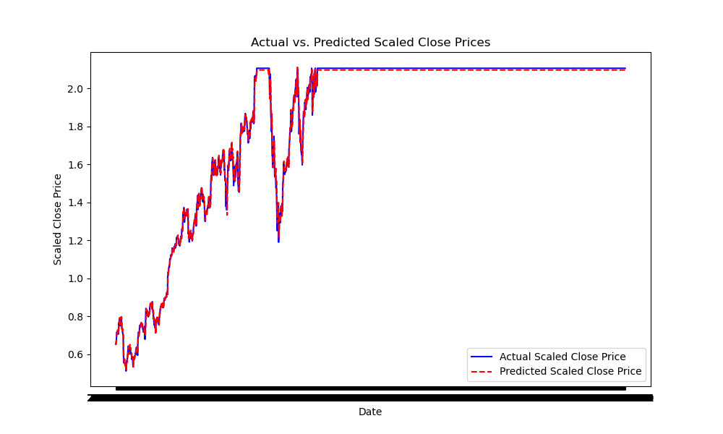
Results
EDA Findings:
Upward trend in stock prices (1980–2025).
Scaled Close prices normally distributed.
High correlations (~0.9–1.0) among price columns; weak volume-price correlation.
Model Performance: Linear Regression RMSE ~0.1234, MAE ~0.0987, indicating moderate accuracy.
Dashboard: Interactive visuals showing trends, distributions, correlations, and predictions.

Slide 5
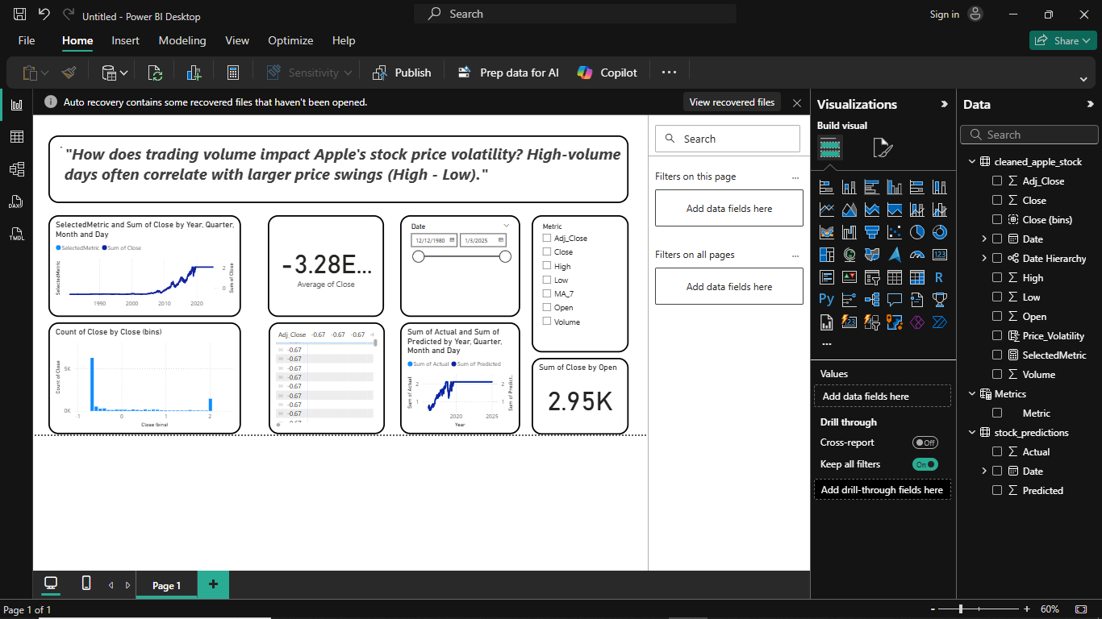
Recommendations
Use the upward trend for long-term investment strategies.
Leverage MA_7 for trend-based trading signals.
Consider additional features (e.g., market sentiment) due to weak volume-price correlation.
Use the Power BI dashboard for real-time monitoring of stock trends.

Slide 6
Future Work
Explore advanced models (e.g., ARIMA, LSTM) for better accuracy.
Incorporate external data (e.g., news sentiment, economic indicators).
Enhance dashboard with real-time data feeds.
Test predictions on other stocks for generalizability.

Slide 7
Dataset source
Dataset source : blob:https://www.opendatabay.com/a29bf918-8c02-4990-abf4-9224ddb5cfba

